Slide 1
Explainable Prediction of Parkinson's Disease from Resting-State Functional MRI Using Hybrid
3D CNN-LSTM Model
Presented By
Group 17
22266008 Salman Ibne Eunus
22273013 Asika Islam
23273003 Mitheela Das Armisha
23273004 Sakib Rokoni

Slide 2
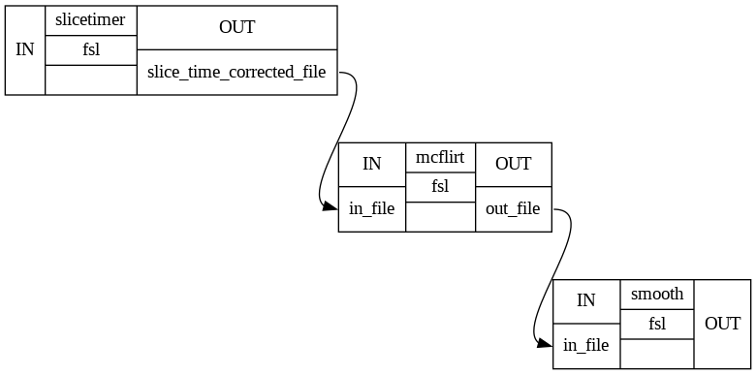
Data Preprocessing
Data obtained in .NII or NIIFTI (Neuroimaging Informatics Technology Initiative) format, preprocessed using techniques like - sliced time correction, motion correction and gaussian smoothing.
It is then converted to DICOM Format for machine learning model using nii2dcm package. Then images in DICOM format are converted into features and labels.

Slide 3
Choosing the Model
(Proposed model)
CNN
LSTM
LIME
Finding patterns in images to recognize objects, classes, and categories.
Use for temporal dependency for 4D data
To predict model accurate

Slide 4
Deep Learning Model
In general, the term “hybrid” refers to something that is a mixture of two or more things. In the context of machine learning, a hybrid model is a model that combines the strengths of two or more different models to achieve better performance than any of the individual models alone .
CNN-LSTM is a hybrid model that combines the strengths of Convolutional Neural Networks (CNNs) and Long Short-Term Memory (LSTM) networks. CNNs are excellent at extracting spatial features from images, while LSTMs are great at capturing temporal dependencies in sequential data. By combining these two models, CNN-LSTM can effectively capture both spatial and temporal features in data, making it a powerful tool for image and sequence classification tasks.
We are also using Explainable AI to correctly pinpoint what our model is predicting and in which region it is predicting using tools like - LIME.

Slide 5
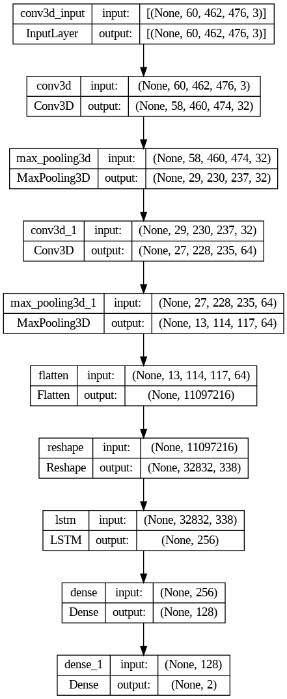
Deep Learning Model
(Hybrid model)
CNN-LSTM

Slide 6
Result Analysis
We will be using metrics like - accuracy, AUC, etc. We are also using data augmentation techniques like - height shift, vertical flip, etc.
Dictionary Learning is used which is better than Independent Component Analysis (ICA) as shown in many literature and experiments.
We are using Dictionary Learning to reduce the dimensionality of 4D fMRI data. The fMRI data are transformed into 30 independent components.
Our experiment shows that dictionary learning outperforms ICA, is more stable, and thus leads to better statistical analysis.

Slide 7
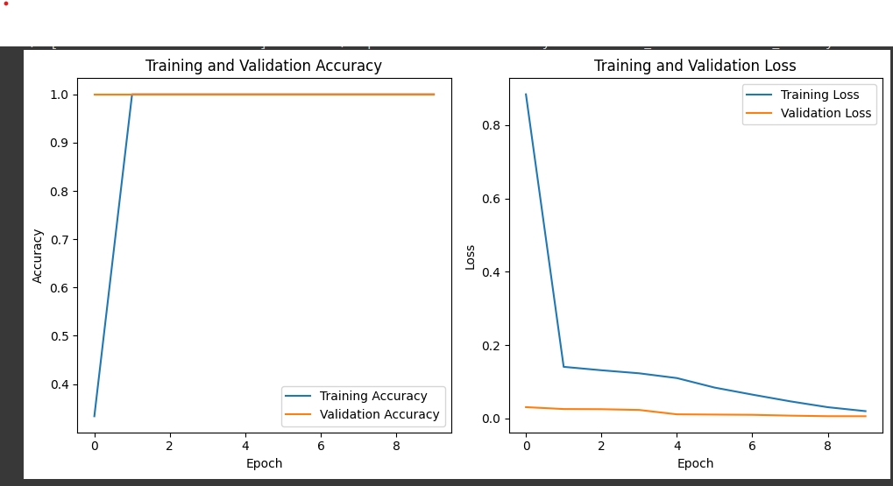
Result
ACCURACY 96%
Loss 0.1 %

Slide 8


